Slide 1
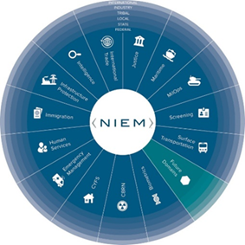
????? Domain Value Proposition
Presentation to NBAC
Date

Slide 2
Value proposition
??? COI
Best practice model to align existing ??? data standards with DHS and external stakeholders
Promotes community-based agreement on data element names and definitions
Supports reuse of definitions within concrete, implementable data syntaxes
Provides a framework for information exchange specifications with machine-testable conformance
Improves interoperability – making data visible, accessible and understandable within enterprise
NIEM Community
Increases use of a common and standard data and information sharing model for ???
Using NIEM increases interoperability within the ??? and other federal, state, local and tribal entities
Reduces development and maintenance costs for any non-??? entity seeking information sharing links
??? Domain broadens accessibility of information to the NIEM community from ???
BANNER

Slide 3
Governance & stakeholders
Domain Basics / Support
Domain Name – ???
Domain Organization – ???
Steward – ???
Domain POC – ???
Model Content – ???
Potential Stakeholders
List Stakeholders

Slide 4
POA&M
Domain Standup
Leadership meeting (NMO-prospective domain) – Date
Draft DSA – Date
POA&M
??? Domain nomination to NBAC – Date
NBAC Vote/Recommendation – Date
Domain Standup (cont.)
ESC Formal Endorsement of Nomination DSA – Date
Kickoff Meeting – Date
Draft Domain Charter – Date
Step | Date | Content Development Activities
1 |  | Identify/ Develop use case scenarios
2 |  | Establish Information Exchange Requirements (IER) from use cases
3 |  | Identify Data components from IER’s and logical data model
4 |  | Develop NIEM ??? Domain Model with data components
5 |  | Community review of domain model
6 |  | Publish domain model

Slide 5
BACKUP

Slide 6
??? Business Case
Purpose
Provide leadership an assessment of the benefits and value that a ??? Domain brings to ??? and the NIEM Community
BLUF
??? Domain will:
Broaden accessibility of information to the NIEM Community from DHS
Improve data and information sharing within DHS and between DHS and stakeholders
Strengthen DHS integration into the national emergency response system for ongoing national security missions

